Slide 1
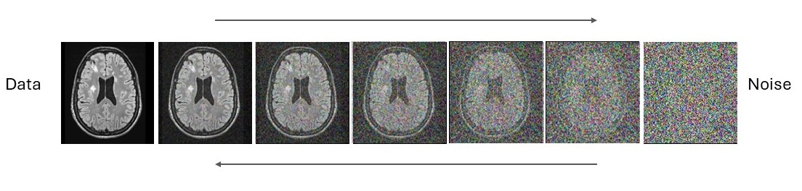
Diffusion-Based Filling and Synthesis of Multiple Sclerosis Lesions
Master Thesis Presentation Experts: PD Dr. Richard McKinley, Dr. Ivan Diaz
Vinzenz Uhr
12.09.2024
Notes:
Ein und ausatmen

Slide 2
Topics
Diffusion-Based Filling and Synthesis of Multiple Sclerosis Lesions
Introduction
Methods
Models
Dataset
Results
Discussion
Conclusions
Notes:
Classic procedure

Slide 3
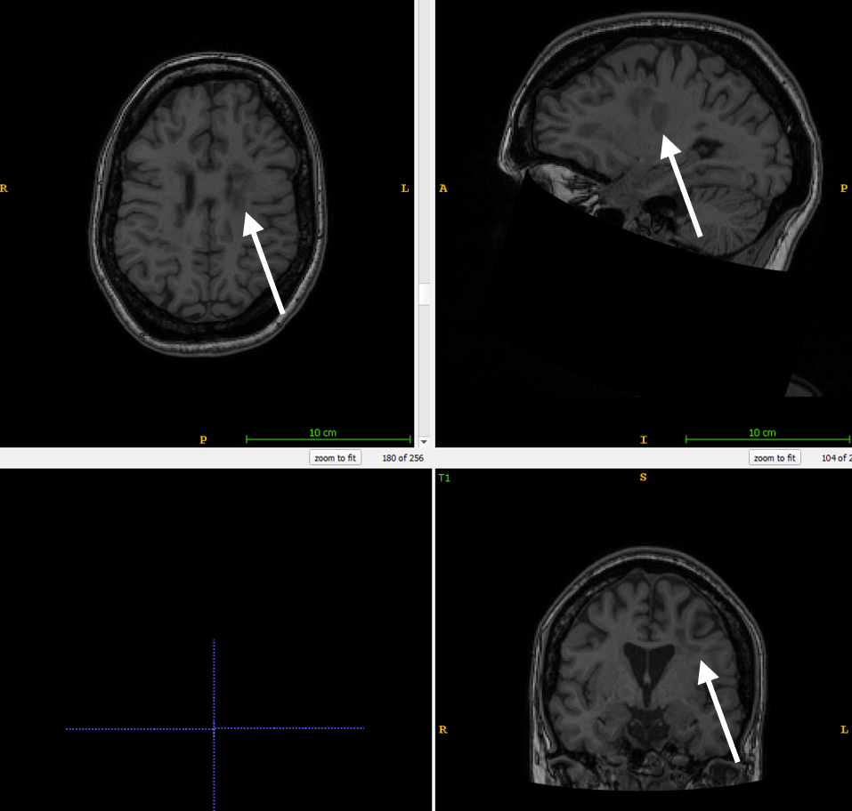
Multiple Sclerosis and Lesion Filling
Diffusion-Based Filling and Synthesis of Multiple Sclerosis Lesions
Multiple sclerosis (MS) is a neurological disease
Damages the coating of the nerves (myelin), which becomes visible as lesions on an MRI scan
Computational methods on MRI scans (e.g. cortical thickness measurements) can be affected by the presence of white matter (WM) lesions [1]
Countermeasure is lesion filling
T1w brain MRI with lesions
Notes:
Dark spots around the ventricles
Lesion filling was simple with brain segmentation and fill in randome white matter intensities

Slide 4
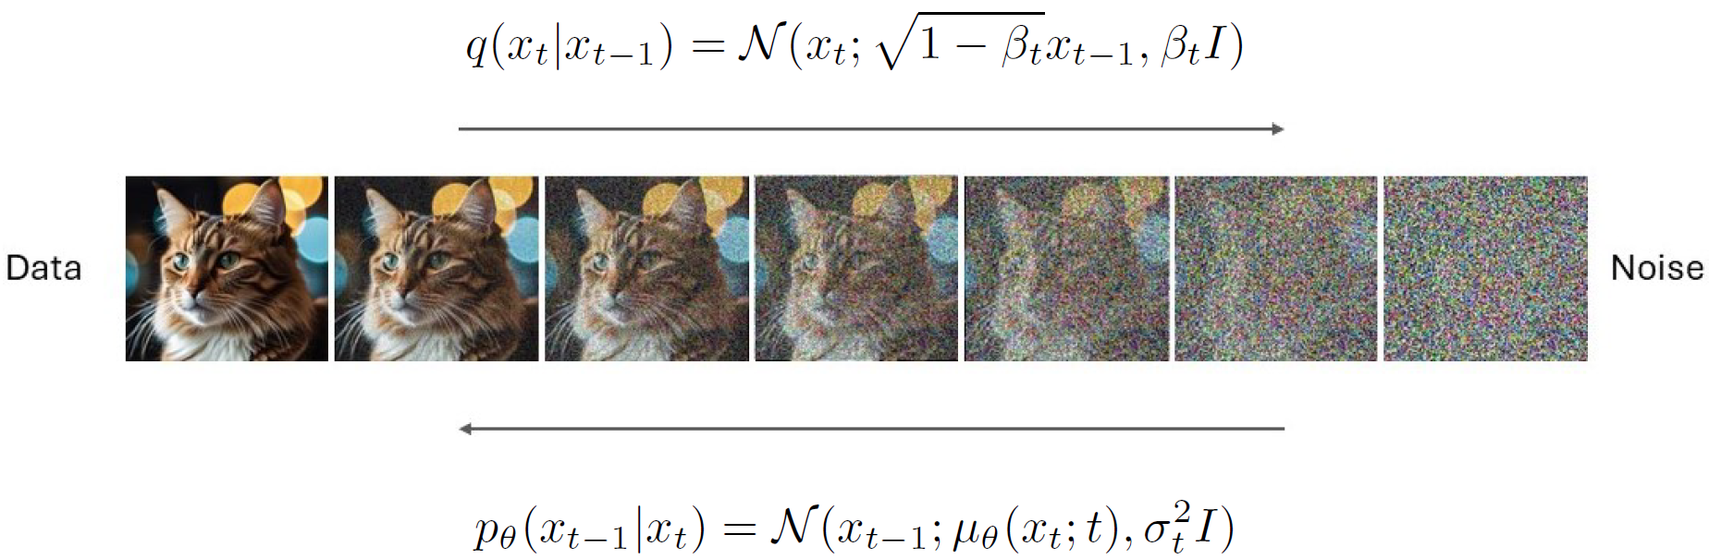
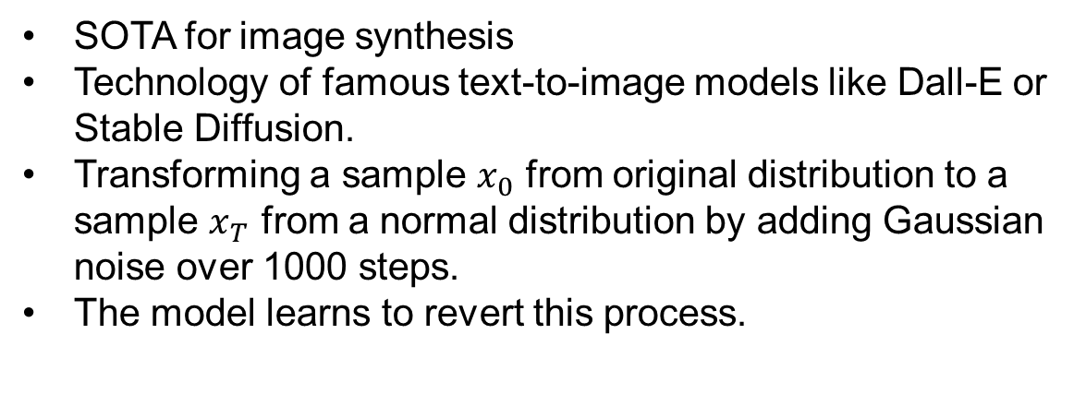
Noise Diffusion Models [2]
Diffusion-Based Filling and Synthesis of Multiple Sclerosis Lesions
SOTA for image synthesis
Technology of famous text-to-image models like Dall-E or Stable Diffusion.
Transforming a sample $x_{0}$ from original distribution to a sample $x_{T}$ from a normal distribution by adding Gaussian noise over 1000 steps.
The model learns to revert this process.
Notes:
In recent years, deep learning has emerged as a powerful tool in medical image analysis

Slide 5
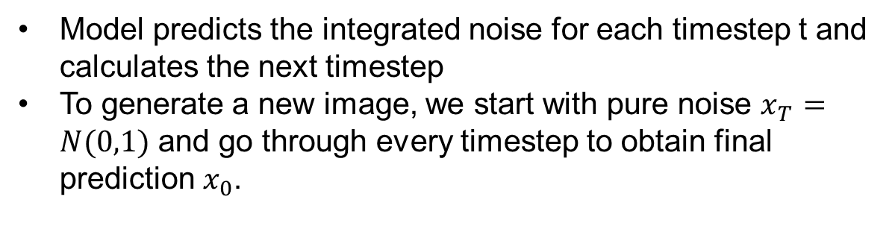
Noise Diffusion Models
Diffusion-Based Filling and Synthesis of Multiple Sclerosis Lesions
Model predicts the integrated noise for each timestep t and calculates the next timestep
To generate a new image, we start with pure noise $x_{T}=N(0,1)$ and go through every timestep to obtain final prediction $x_{0}$.

Slide 6
Noise Diffusion Models
Diffusion-Based Filling and Synthesis of Multiple Sclerosis Lesions
Noise diffusion models are data hungry
Data scarcity for annotated MS Lesions
Synthetic data generation is promising alternative

Slide 7
Goals
Diffusion-Based Filling and Synthesis of Multiple Sclerosis Lesions
Develop a method to fill WM lesions in MR-images using noise diffusion models.
Create a noise diffusion model capable of generating new, synthetic WM lesions within MR-images.
Assess the impact of lesion filling on cortical thickness measurements using current tools to evaluate their robustness.

Slide 8
Methods

Slide 9
Models
Diffusion-Based Filling and Synthesis of Multiple Sclerosis Lesions
Lesion Filling Conditional
Model conditions on a binary mask and a voided MR-image
Incorporated through concatenation at each timestep t

Slide 10
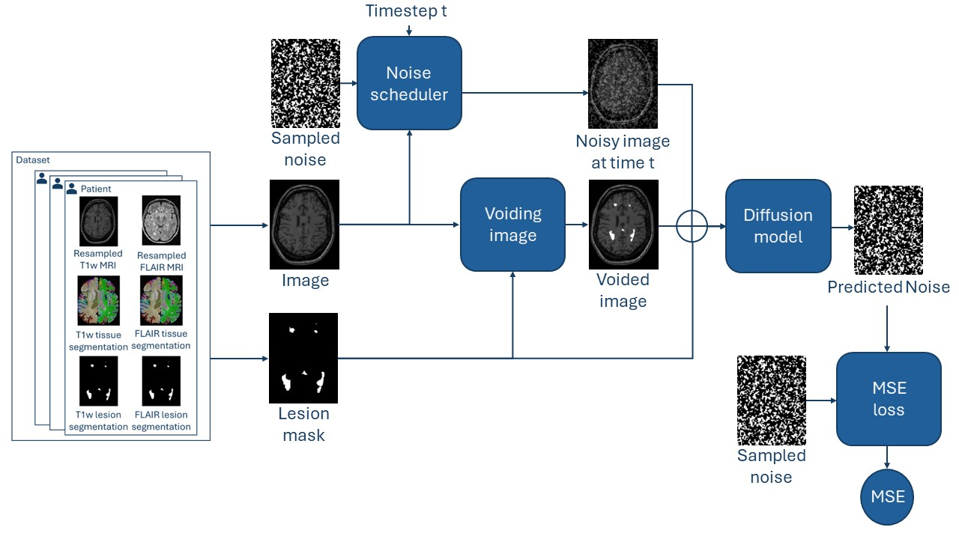
Models
Diffusion-Based Filling and Synthesis of Multiple Sclerosis Lesions
Lesion Filling Conditional
Training step of conditional model

Slide 11
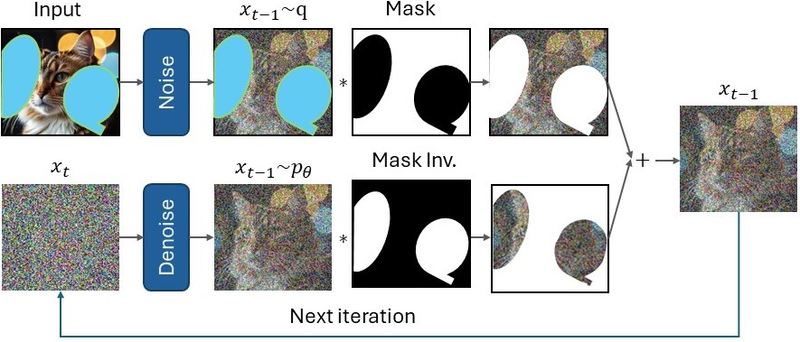
Models
Diffusion-Based Filling and Synthesis of Multiple Sclerosis Lesions
Lesion Filling Unconditional
Train a noise diffusion model without conditioning
Use RePaint [3] approach to condition the generation process by replacing pixels outside the mask with the MR-scan
RePaint sampling approach
Notes:
When we sample from this model we would get a random brain mri, but we don’t want a random brain mri we want to inpaint our own mr-image
Outside the mask, the pixels are replaced with the original image, and inside the mask, the model inpaints some realistic content fitting the outside, which in our case would be inpainting white matter.
Advantages: Mask free training, tumor mask

Slide 12
Models
Diffusion-Based Filling and Synthesis of Multiple Sclerosis Lesions
Lesion Synthesis Conditional
Like conditional lesion filling
Key distinction: Training target is inpainting WM lesions

Slide 13
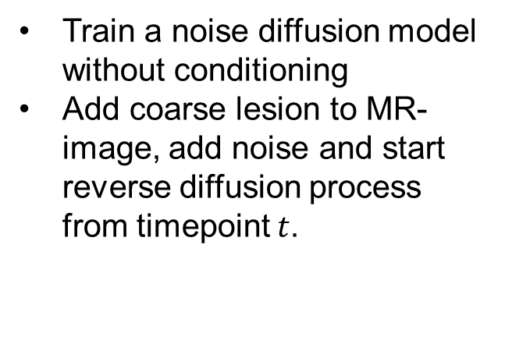
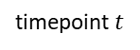
Models
Diffusion-Based Filling and Synthesis of Multiple Sclerosis Lesions
Lesion Synthesis Unconditional
Train a noise diffusion model without conditioning
Add coarse lesion to MR-image, add noise and start reverse diffusion process from timepoint $t$.
timepoint $t$
Diffusion process
Notes:
Trained a model with mr-images with lesions. Meaning if we sample from the unconditional model we ould get a random mr-image with lesions.
And the idea is for synthetically adding a new lesion by jumping into the middle of the diffusion process
And hope it refines the coarse lesion to a nice realistic lesion

Slide 14
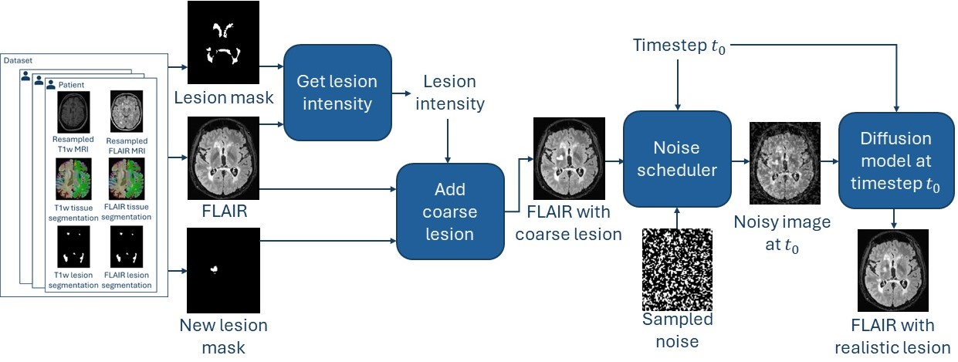
Models
Diffusion-Based Filling and Synthesis of Multiple Sclerosis Lesions
Lesion Synthesis Unconditional
Unconditional lesion synthesis pipeline
Notes:
We jump into the middle of the diffusion process at a specific timepoint t
We sample some noise and add the amount of noise based on the initial timepoint
We then start the diffusion process and let the model refine the coarse lesion

Slide 15
Datasets
Diffusion-Based Filling and Synthesis of Multiple Sclerosis Lesions
Different datasets with healthy and MS patients with lesions
T1w and FLAIR images
Binary lesion masks
Synthetic random circle masks for lesion filling
Notes:
Regarding lesion filling, we asked ourself whether the existing mask distribution was sufficient.
We therefore enriched our mask dataset by synthetic random circles. We know that these are unrealistic masks, but they increased the diversity of our mask dataset. We wanted to analyze how these masks influence the performance.

Slide 16
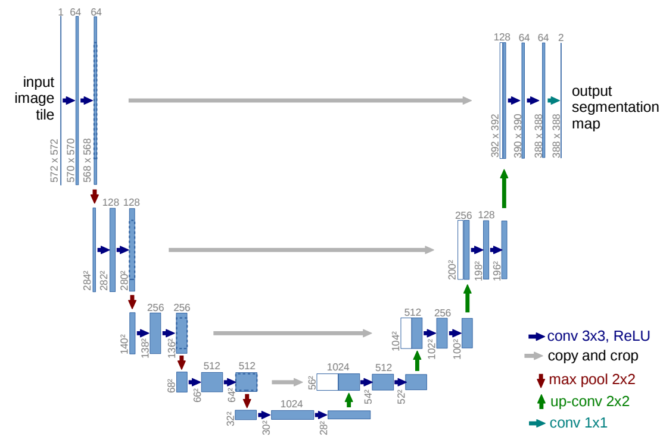
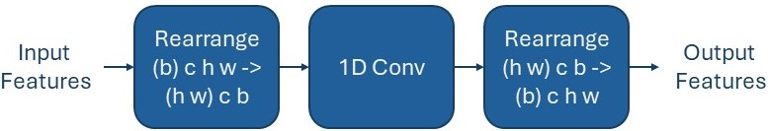
U-Net Architectures
Diffusion-Based Filling and Synthesis of Multiple Sclerosis Lesions
2D U-Net
Pseudo 3D U-Net
Pseudo 3D U-Net layer
U-Net architecture [4]
Notes:
We used a classical unet architecture
Problem is that 3D MRI are too big to fit
transversal slices
To improve the consistency
After every 2D convolution
1D conv in direction of the batch. So for one specific pixel it does a 1D convolution through the batch

Slide 17
Results
Notes:
Divide it into two parts: lesion filling and lesion synthesis

Slide 18
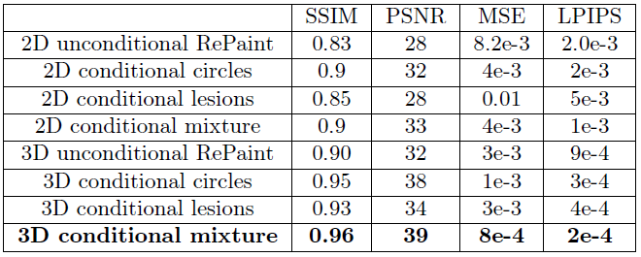
Lesion Filling: Evaluation
Diffusion-Based Filling and Synthesis of Multiple Sclerosis Lesions
Winner: Conditional model with pseudo 3D-Unet and 50% synthetic random circle masks
Pseudo 3D: +5-8%
Synthetic masks: +3-5%

Slide 19
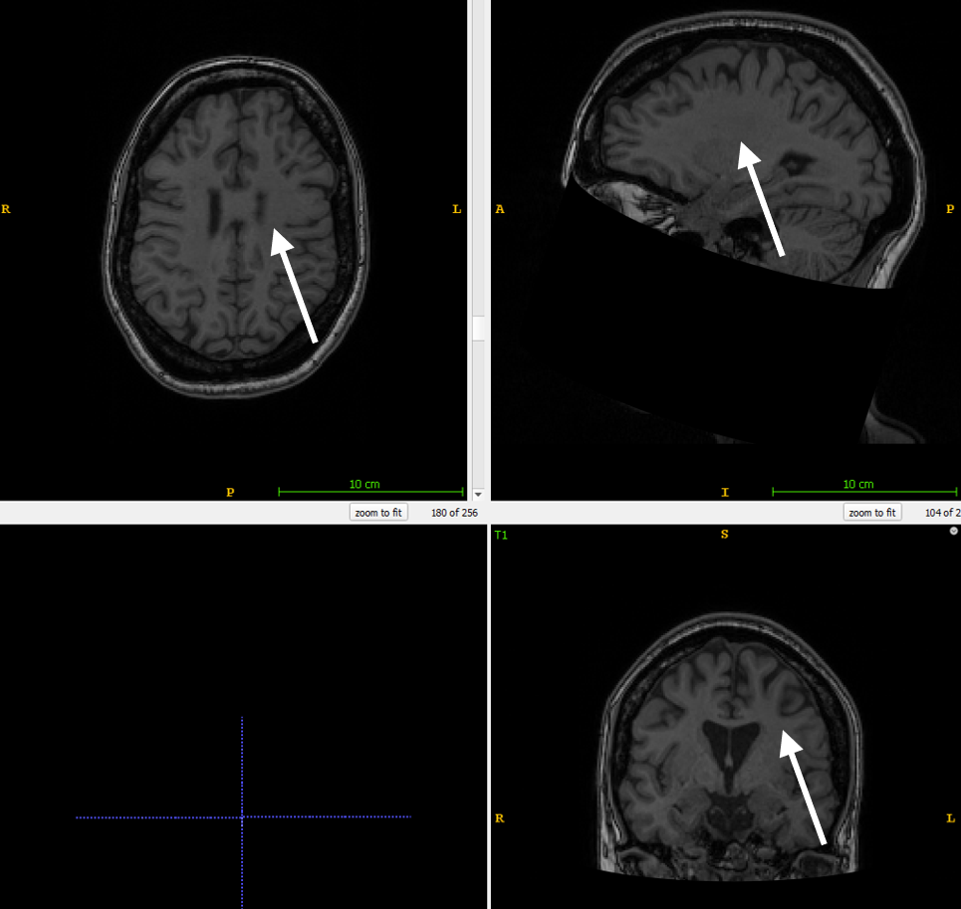
Lesion Filling: Examples
Diffusion-Based Filling and Synthesis of Multiple Sclerosis Lesions
T1w before lesion filling
T1w after lesion filling

Slide 20
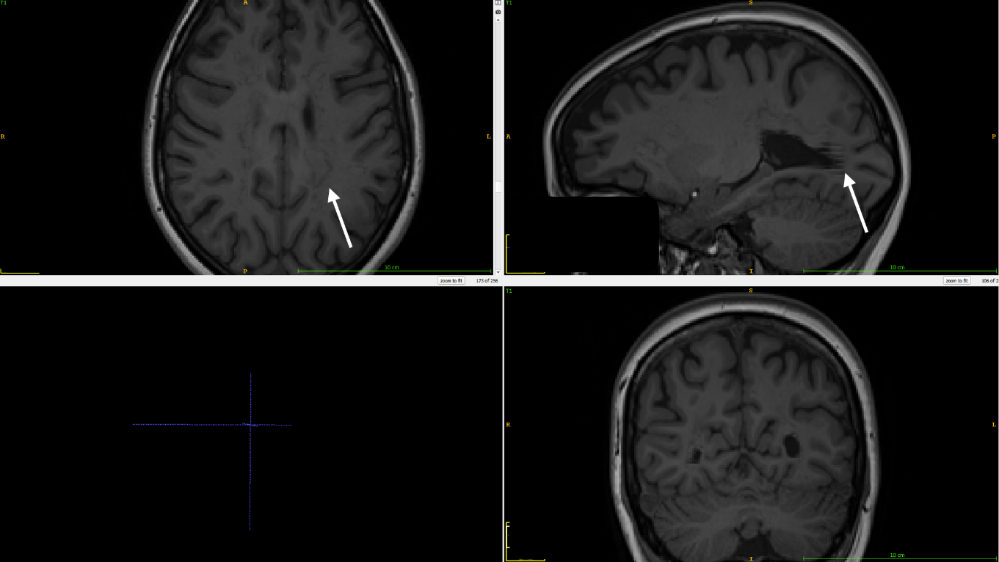
Lesion Filling: Solutions against Artifacts
Diffusion-Based Filling and Synthesis of Multiple Sclerosis Lesions
Dilation to prevent border artifacts
Pseudo 3D layer to prevent stripe artifacts
Border (left arrow) and stripe artifacts (right arrow)

Slide 21
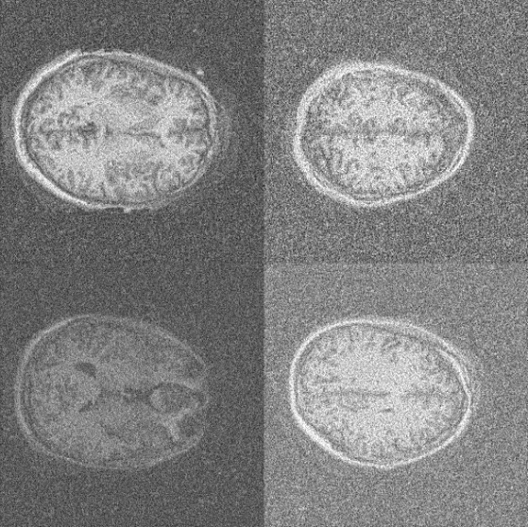
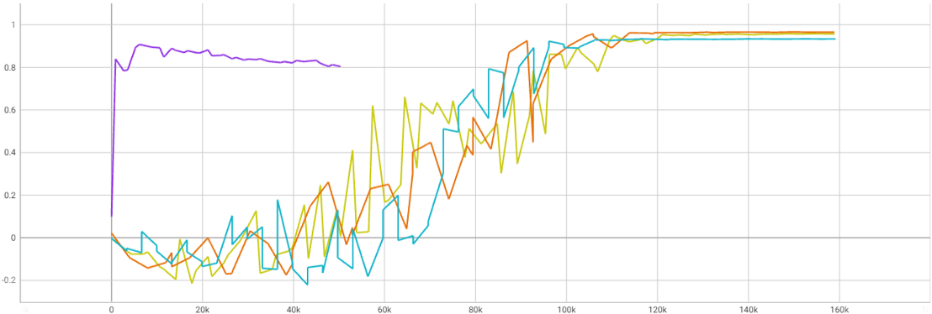
Lesion Filling: Training Duration
Diffusion-Based Filling and Synthesis of Multiple Sclerosis Lesions
RePaint achieves peak SSIM of 0.9 at 6000 training steps
Conditional models require 90’000 steps for comparable performance
Unconditional model is still underdeveloped
SSIM score of the 4 3D models unconditional RePaint (violet), conditional mixture (red), conditional circles (yellow) and conditional lesions (blue).
Samples of unconditional model without RePaint
Notes:
RePaint achieves for inpainting
But with strong guidance of RePaint the underdevelopped model achieves good performance for inpainting.

Slide 22
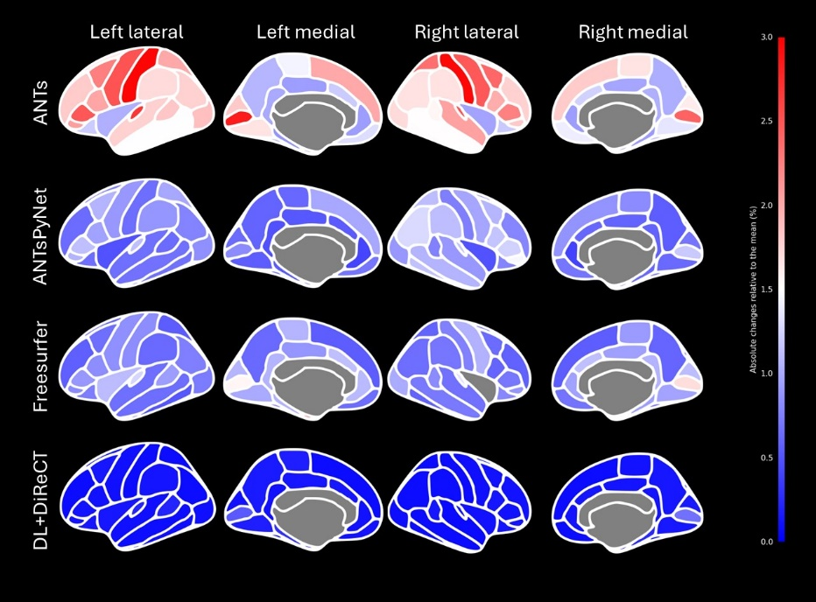
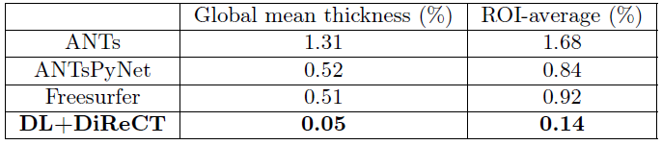
Lesion Filling: Robustness measurements
Diffusion-Based Filling and Synthesis of Multiple Sclerosis Lesions
Comparing cortical thickness measurements before and after lesion filling
Mean reproducibility errors
Color-coded reproducibility errors of the ROI-wise average cortical thicknesses.

Slide 23
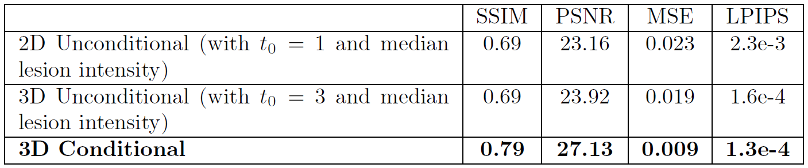
Lesion Synthesis: Evaluation
Diffusion-Based Filling and Synthesis of Multiple Sclerosis Lesions
Winner: Conditional model with pseudo 3D-Unet

Slide 24
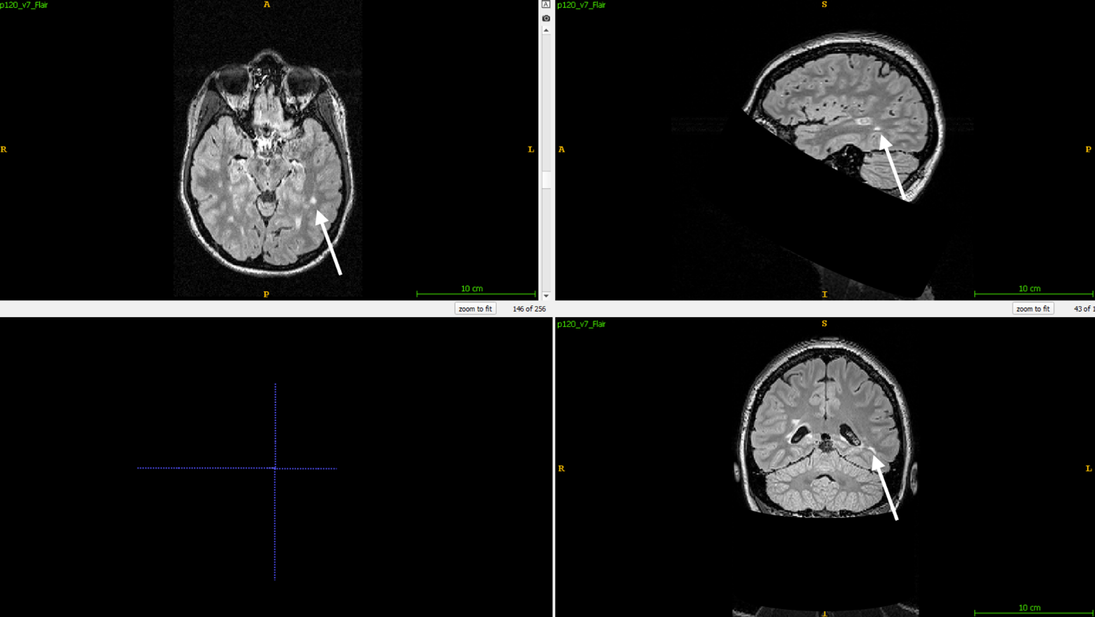
Lesion Synthesis: Examples
Diffusion-Based Filling and Synthesis of Multiple Sclerosis Lesions
Example of synthetic lesion

Slide 25
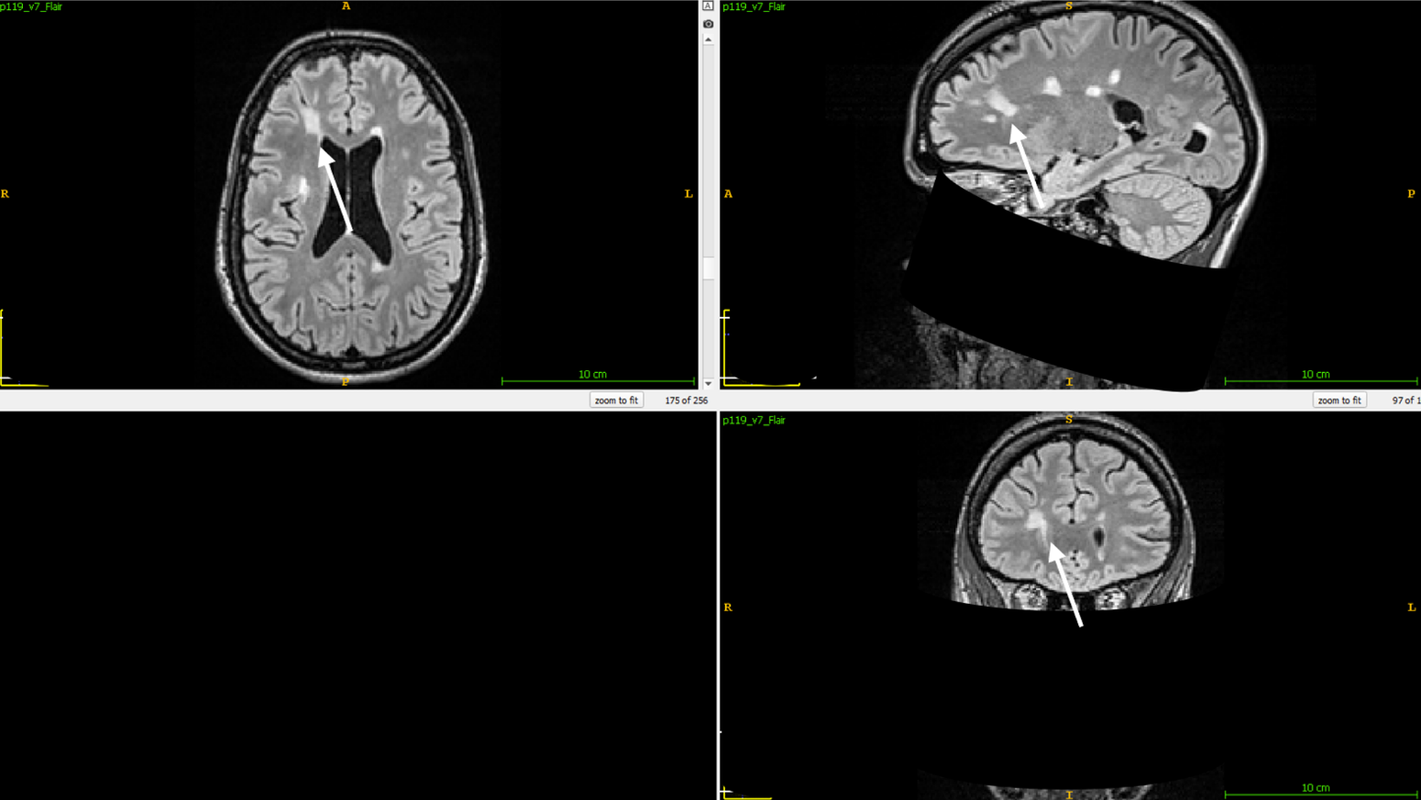
Lesion Synthesis: Examples
Diffusion-Based Filling and Synthesis of Multiple Sclerosis Lesions
Example of synthetic lesion

Slide 26
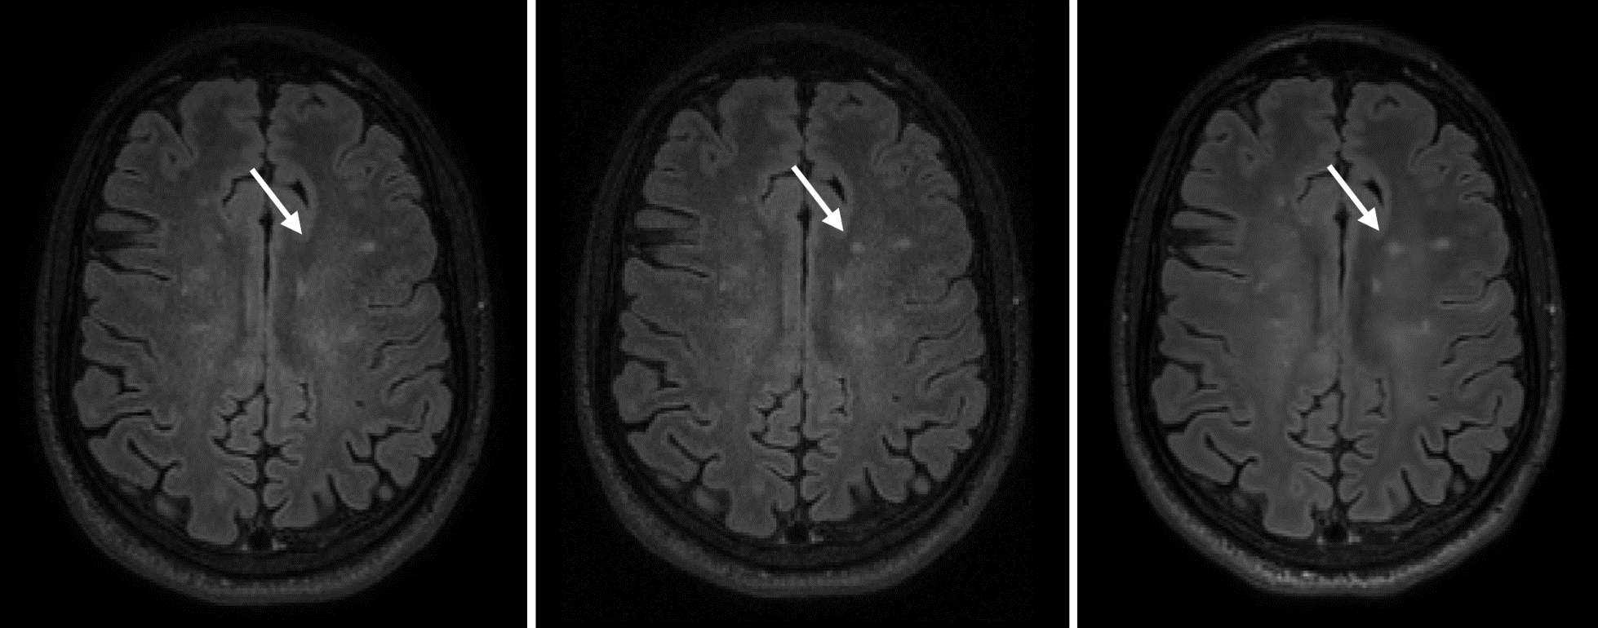
Lesion Synthesis: Examples
Diffusion-Based Filling and Synthesis of Multiple Sclerosis Lesions
(1) Before and (2) after adding a synthetic lesion to healthy tissue and (3) at a later timepoint with a natural new lesion at the same location.
Notes:
Here we have an example, where we had multiple timepoints per patients.
At the left side you can see a MR-image of a patient and on the right side ist the same patient couple of months later.
And he developped a lesion at the location of the white arrow.
I then used the first image and the mask of the second image to inpaint a new lesion. You can see the result in the middle.

Slide 27
Lesion Synthesis: Qualitative Evaluation
Diffusion-Based Filling and Synthesis of Multiple Sclerosis Lesions
Set of 20 examples
Neuroradiologist nr. one identified three synthetically added lesions
Neuroradiologist nr. two detected only one.
Notes:
confirms the authenticity of the synthetic lesions

Slide 28
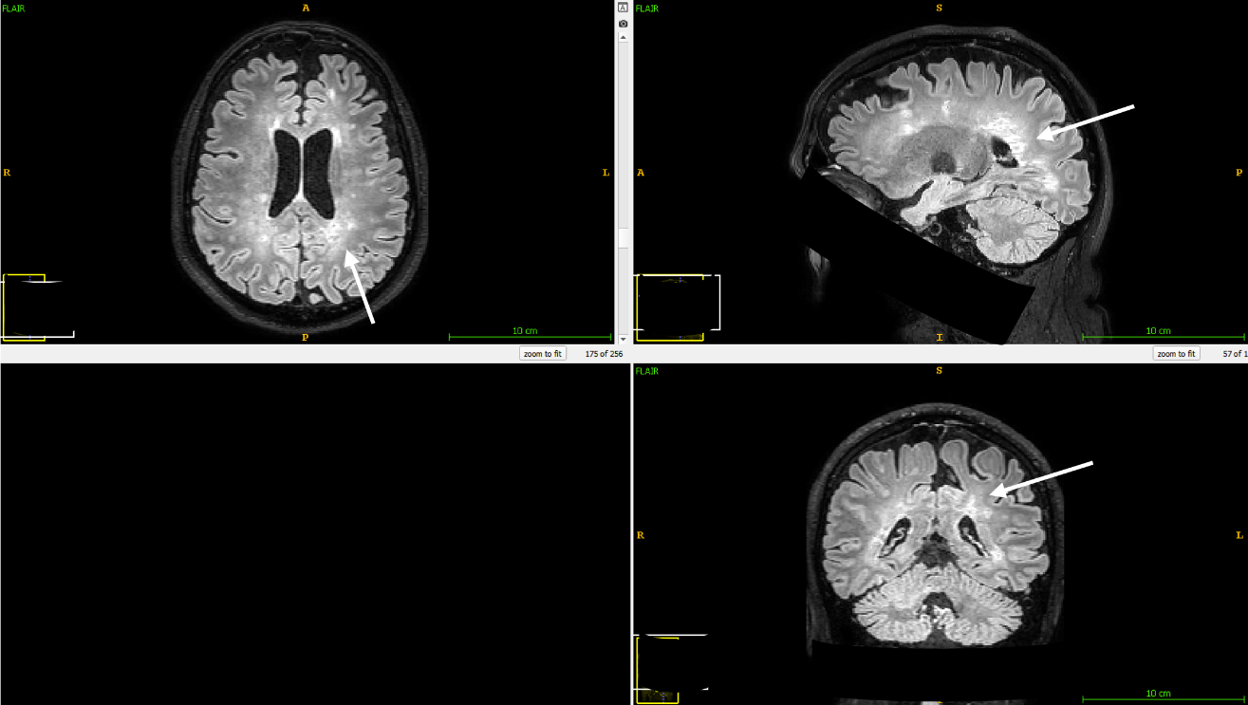
Lesion Synthesis: Artifacts with unconditional model
Diffusion-Based Filling and Synthesis of Multiple Sclerosis Lesions
Removal of coarse lesion
High sensitivity to initial timestep and lesion intensity
Synthetic lesion: Partial lesion removal resulted in diffuse patterns
Notes:
A significant challenge we encountered was the model tried to remove the coarse lesion.
We could partially avoid this by adjusting the initial timestep and lesion intensity, but we were unable to achieve consistently satisfactory results.

Slide 29
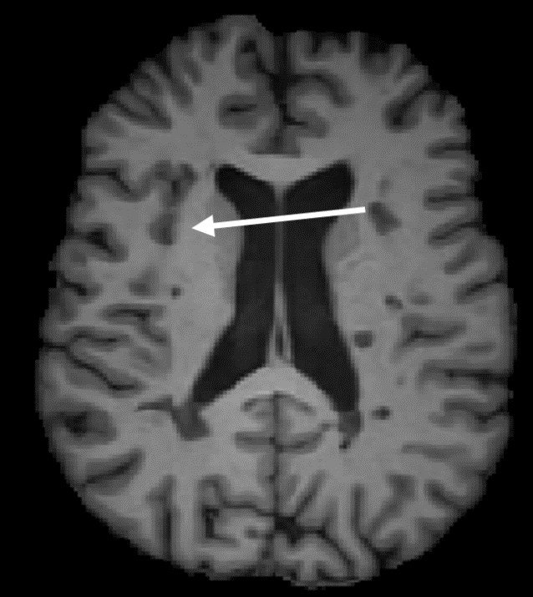
Lesion Synthesis: Artifacts with unconditional model
Diffusion-Based Filling and Synthesis of Multiple Sclerosis Lesions
Lesions got inpainted as gray matter with T1w images.
Synthetic lesion inpainted as GM

Slide 30
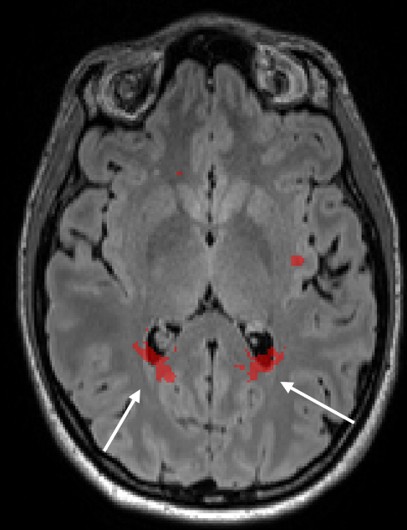
Lesion Synthesis: Mask Registration
Diffusion-Based Filling and Synthesis of Multiple Sclerosis Lesions
Inpainting needs masks
Registration of lesion masks across patients has often poor results
Poorly registered lesion mask

Slide 31
Discussion
Notes:
Divide it into two parts: lesion filling and lesion synthesis

Slide 32
Lesion Filling
Diffusion-Based Filling and Synthesis of Multiple Sclerosis Lesions
Good results
Conditional model was better
RePaint converges faster, but overfits
Pseudo 3D U-Net and synthetic random circle masks improved performance
Robustness varies between different tools
Deep learning tools are more robust to WM lesions
Lesion filling might become obsolete in the future

Slide 33
Lesion Synthesis
Diffusion-Based Filling and Synthesis of Multiple Sclerosis Lesions
Good results with conditional model
Pseudo 3D U-Net improved performance
Unconditional model never delivered satisfactory results
Next step: Train model with synthetic dataset
Better mask registration process is needed
Notes:
especially because neuroradiology could not recognise them.

Slide 34
Conclusions
Diffusion-Based Filling and Synthesis of Multiple Sclerosis Lesions
We could train good models for lesion filling and synthesis
Lesion filling might become obsolete
Next step for lesion synthesis is train a model with synthetic dataset

Slide 35

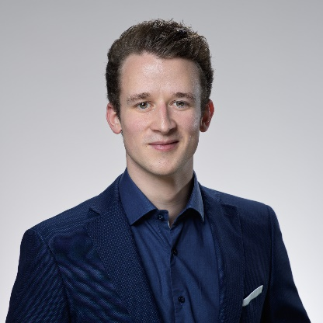
Thank you for your attention!
Thesis repository: https://github.com/vinzenzuhr/Thesis_Diffusion_Lesions
Vinzenz Uhr vinzenz.uhr@gmail.com

Slide 36
Bibliography
Diffusion-Based Filling and Synthesis of Multiple Sclerosis Lesions
M. Battaglini, M. Jenkinson, and N. De Stefano. Evaluating and reducing the impact of white matter lesions on brain volume measurements. Human Brain Mapping, 33(9), 2012.
J. Ho, A. Jain, and P. Abbeel. Denoising diffusion probabilistic models. In Advances in Neural Information Processing Systems, volume 2020-December, 2020.
A. Lugmayr, M. Danelljan, A. Romero, F. Yu, R. Timofte, and L. Van Gool. RePaint: Inpainting using Denoising Diffusion Probabilistic Models. In Proceedings of the IEEE Computer Society Conference on Computer Vision and Pattern Recognition, volume 2022-June, 2022.
O. Ronneberger, P. Fischer, and T. Brox. U-Net: Convolutional Networks for Biomedical Image Segmentation. 5 2015.

Slide 37
Thank you for your attention!
Thesis repository: https://github.com/vinzenzuhr/Thesis_Diffusion_Lesions
Vinzenz Uhr vinzenz.uhr@gmail.com

Slide 38
Backup Slides

Slide 39
Noise Diffusion Models
Diffusion-Based Filling and Synthesis of Multiple Sclerosis Lesions

Slide 40
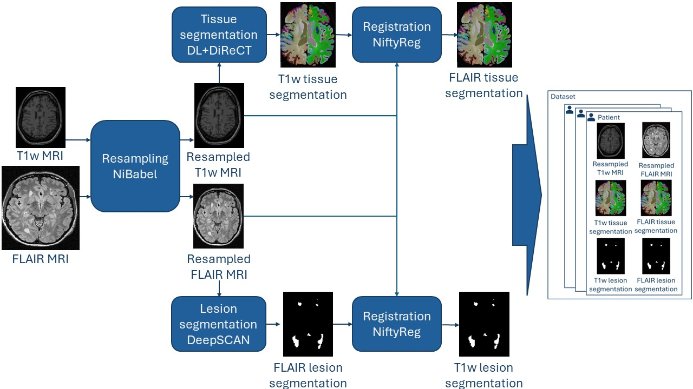
Datasets
Diffusion-Based Filling and Synthesis of Multiple Sclerosis Lesions
Preprocessing
Preprocessing pipeline

Slide 41
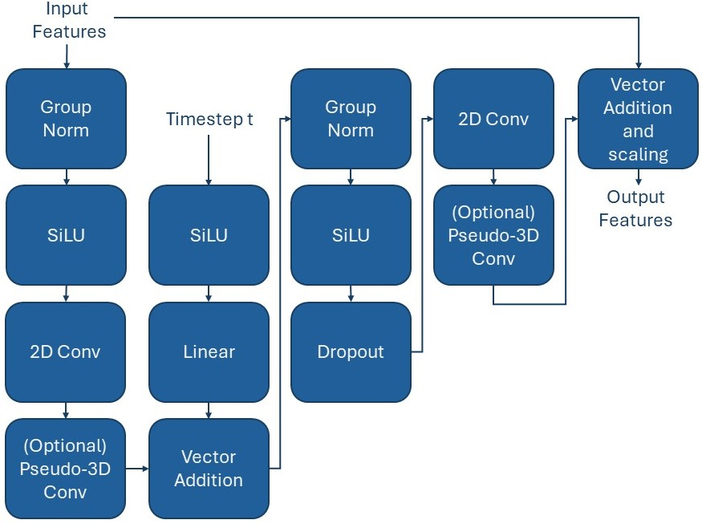
Pseudo 3D U-Net
Diffusion-Based Filling and Synthesis of Multiple Sclerosis Lesions
six feature map resolutions with two convolutional residual blocks per resolution level and one self-attention block.
From highest to lowest resolution the U-Net stages use (128, 128, 256, 256, 512, 512) channels.

Slide 42
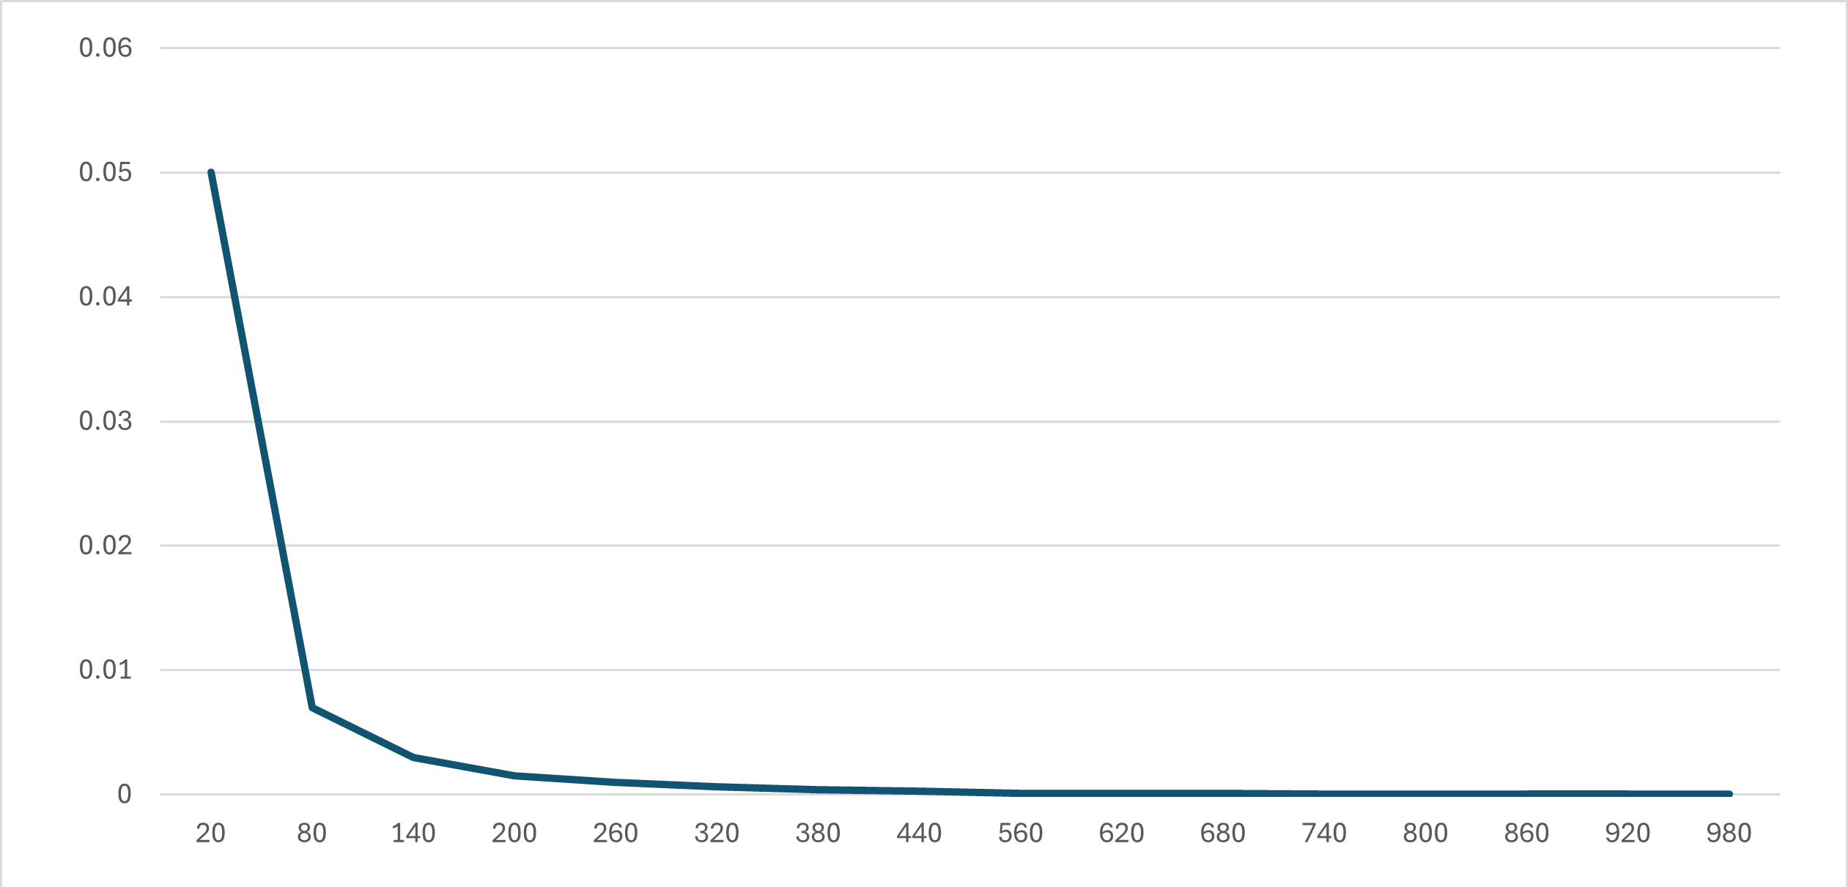
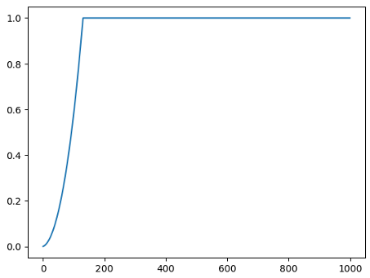
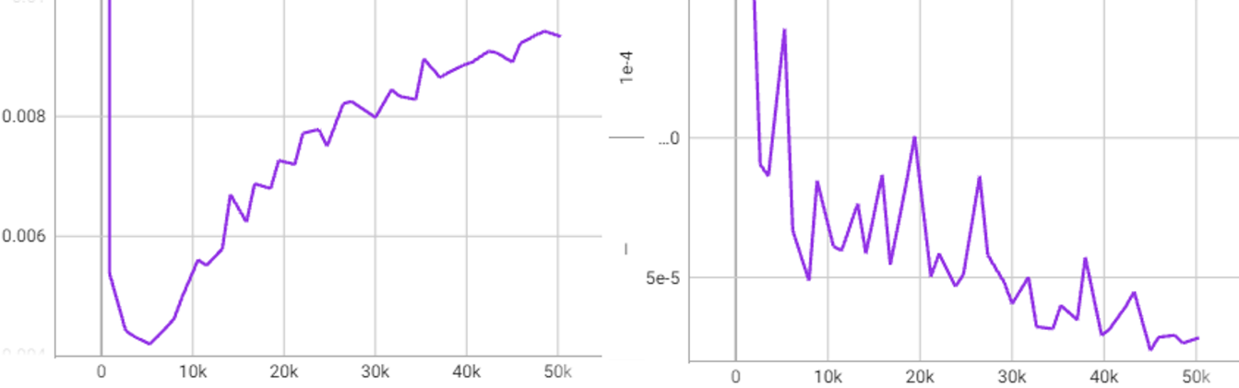
Min-SNR loss
Diffusion-Based Filling and Synthesis of Multiple Sclerosis Lesions
Smaller timesteps overfit faster
Min-SNR reweights loss per timestep
Validation loss of all 1000 timesteps
Validation loss of smaller vs bigger timestep
Loss timestep weights

